Slide 1

Pitstop Challenge
Interactive 3D Formula 1 Pit Garage Simulation in WebGL
Salih Akoğlu (23118080072) | Ediz Gün (23118080082) Department of Computer Engineering

Slide 2


Project Overview
Pitstop Challenge is an interactive 3D simulation developed strictly using low-level WebGL and GLSL.
Users navigate freely through an F1 pit garage, performing rapid component replacements on a vehicle.
Core Technical Features:
Hierarchical Modeling
Proximity-Based Snapping
Dynamic Lighting (Phong)
Procedural Texture Mapping
*Built without relying on any game engine or graphics framework.

Slide 3
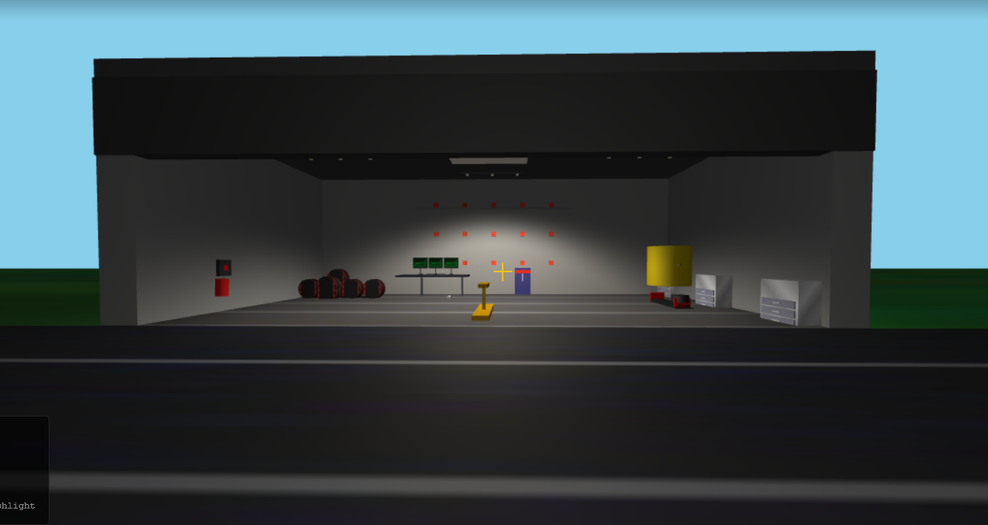
Scene Configuration
■
Full 3D Environment: The camera is initially positioned to view the scene in 3D (not 2D or top-down).
■
Free Navigation: Users utilize WASD keys and mouse look for a free-roaming first-person camera, moving in 3 axes (x, y, z).
■
Diverse Morphologies: The scene contains distinct object shapes:
■
- F1 Car Body (complex multi-part mesh)
■
- Tires (cylindrical)
- Garage Environment (rectangular boxes)
■

Slide 4









Procedural Texturing
At least three different object types feature distinct, dynamically generated textures.
Car Body
Tires
Environment
Features a carbon-fiber and metallic paint texture generated procedurally, reacting to lighting.
Utilizes a matte rubber texture specifically designed to simulate F1 racing slicks.
The garage utilizes concrete/asphalt textures for the floor and distinct textures for the walls.

Slide 5
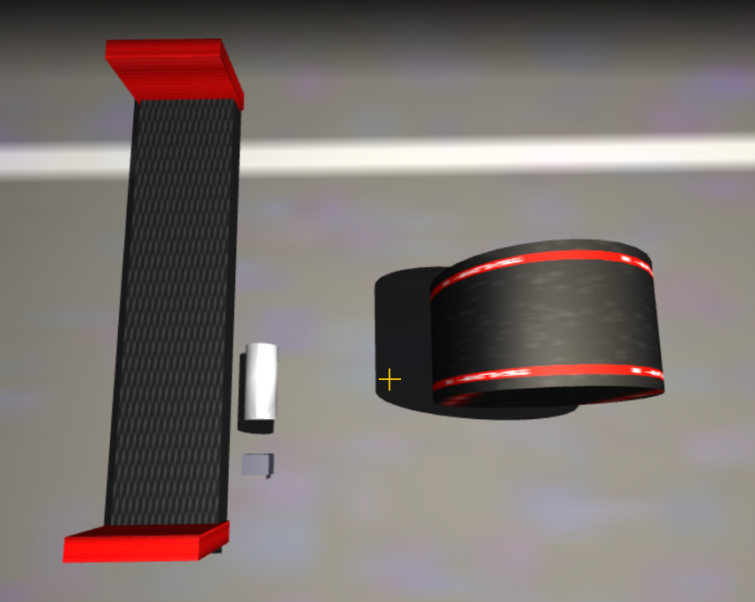

Interactive Components
Three independently controllable objects demonstrate complex user interaction and state management:
■
Tires: Can be picked up (Key 'E'), carried, dropped (Key 'G'), and snapped onto wheel hubs.
■
Front Wing: Modeled as a separate component that can be removed and replaced via proximity checks.
■
Rear Wing Flap (DRS): Toggled via a dedicated key press ('X'), triggering a local rotation animation.
■
Worklight: A portable flashlight object that can be picked up and toggled ('F').

Slide 6

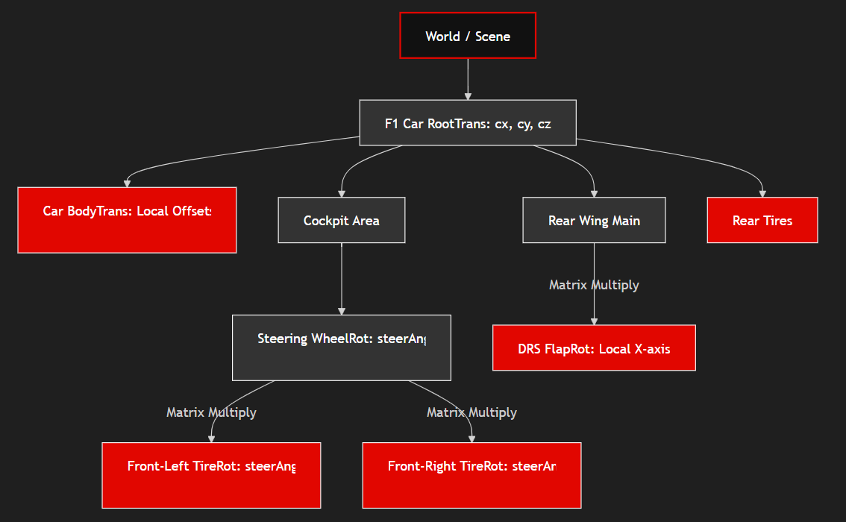
Advanced Transformations
Hierarchical Modeling
The project implements a parent-child hierarchy in the transformation matrix stack. For example, in Cockpit View, the steering wheel acts as a parent node. The front tires are linked as child nodes, ensuring their yaw rotation synchronizes automatically with steering input.
Proximity-Based Snapping
Distance checks (Math.sqrt(dx² + dy² + dz²)) within the render loop govern component attachment. Bringing a held tire close to a vacant hub updates the model state and snaps it into place.

Slide 7
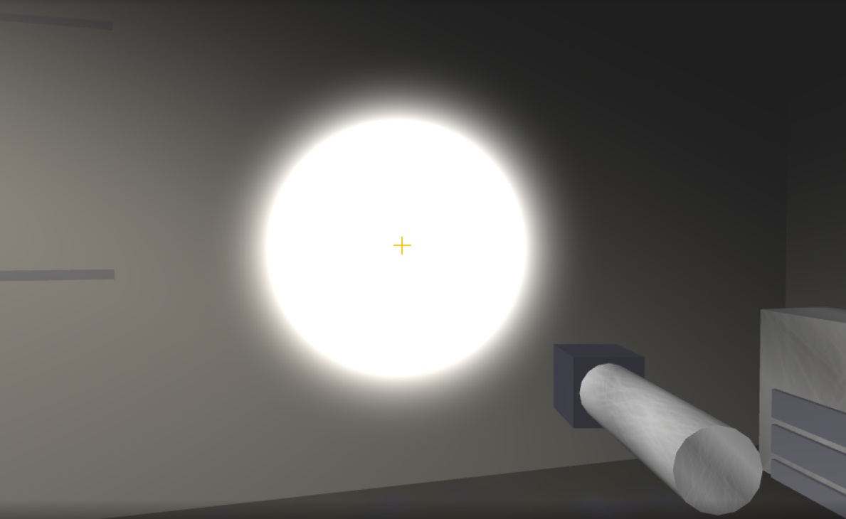
Dynamic Lighting Model
■
Phong Reflection Model: Implemented entirely in GLSL fragment shaders, calculating ambient, diffuse, and specular components.
■
Movable Light Source: A main spotlight (worklight) serves as the primary dynamic source. When carried, it aligns with the camera's forward vector.
■
Adjustable Power: Users can dynamically increase ('R') or decrease ('Q') the flashlight's brightness, affecting the shading on metallic surfaces in real-time.
■
Fixed Lighting: A secondary overhead garage light provides base illumination and projective shadows.

Slide 8









Simulation HUD
Timing System
Progress Panel
Status Indicators
A real-time timer tracks the duration of the pit stop once the car enters the garage.
Visual checklist indicating the status of all four tires and the front wing replacement tasks.
On-screen overlays display current position, steering angle, light power, and active DRS state.

Slide 9

Demo & Questions
Thank you for your attention.

